Slide 1
ADC and DAC Interfacing with 8051

Slide 2
Outline
Sampling
ADC
DAC

Slide 3
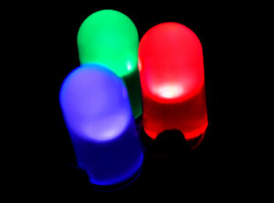
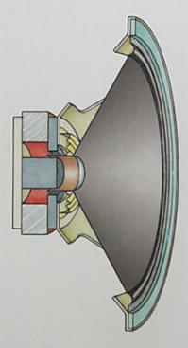
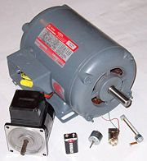
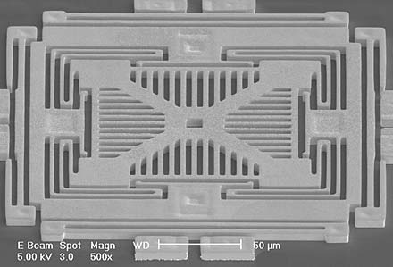
We live in an analog world
Everything in the physical world is an analog signal
  Sound, light, temperature, pressure
Need to convert into electrical signals
  Transducers: converts one type of energy to another
  The physical variable is normally a nonelectrical quantity
    Electro-mechanical, Photonic, Electrical, …
  Examples
    Microphone/speaker
    Thermocouples
    Accelerometers

Slide 4
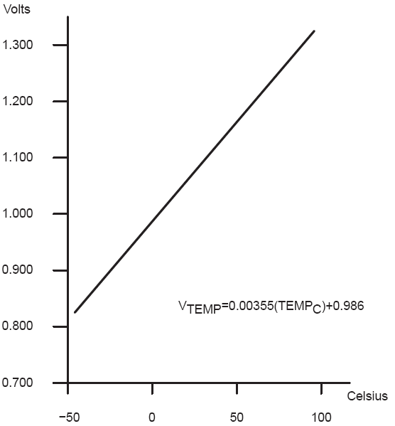
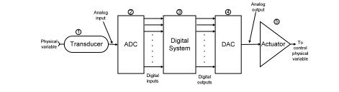
Transducers convert one form of energy into another
Transducers
  Allow us to convert physical phenomena to a voltage potential in a well-defined way.
A transducer is a device that converts one type of energy to another. The conversion can be to/from
electrical, electro-mechanical, electromagnetic, photonic, photovoltaic, or any other form of energy.
While the term transducer commonly implies use as a sensor/detector, any device which converts energy
can be considered a transducer. – Wikipedia.

Slide 5
Many other common sensors (some digital)
Force
  strain gauges - foil, conductive ink
  conductive rubber
  rheostatic fluids
    Piezorestive (needs bridge)
  piezoelectric films
  capacitive force
    Charge source
Sound
  Microphones
    Both current and charge versions
  Sonar
    Usually Piezoelectric
Position
  microswitches
  shaft encoders
  gyros
Acceleration
  MEMS
  Pendulum
Monitoring
  Battery-level
    voltage
  Motor current
    Stall/velocity
  Temperature
    Voltage/Current Source
Field
  Antenna
  Magnetic
    Hall effect
    Flux Gate
Location
  Permittivity
  Dielectric
Source: Forrest Brewer

Slide 6
Going from analog to digital
What we want
How we have to get there
Physical
Phenomena
Engineering Units
Physical
Phenomena
Voltage or
Current
ADC Counts
Engineering Units
Sensor
ADC
Software

Slide 7
Analog-to-Digital Converter (ADC)
The transducer’s electrical analog output serves as the analog input to the ADC
The ADC converts this analog input to a digital output.

Slide 8
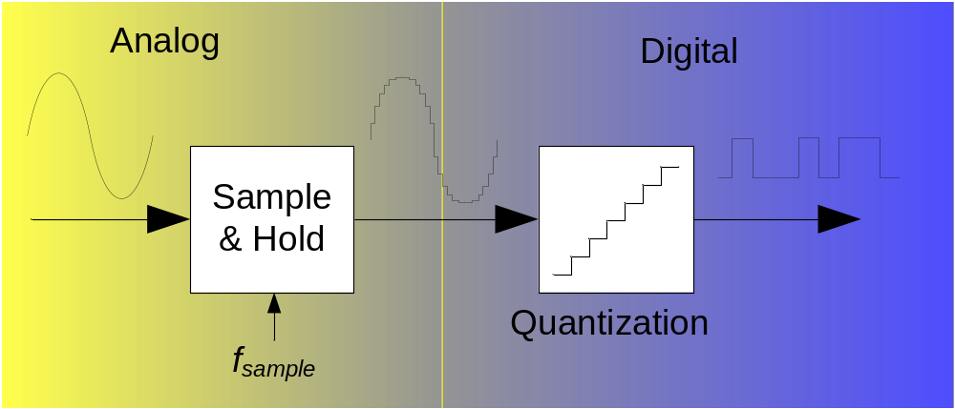
ADC - Scheme
Analog input can be voltage or current (in the following only voltage)
Analog input can be positive or negative (in the following only positive)

Slide 9

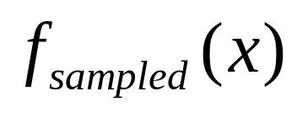


Representing an analog signal digitally
How do we represent an analog signal (e.g. continuous voltage)?
  As a time series of discrete values
  → On MCU: read ADC data register (counts) periodically (T_{s})
Counts
(discrete)
Voltage
(continuous)

Slide 10
2. Characteristic Values of ADCs
Which values characterize an ADC?
What kind of errors exist?
What is aliasing?

Slide 11


Choosing the range
Fixed # of bits (e.g. 8-bit ADC)
Span a particular input voltage range
What do the sample values represent?
  Some fraction within the range of values
  → What range to use?
Range Too Small
Range Too Big
Ideal Range

Slide 12
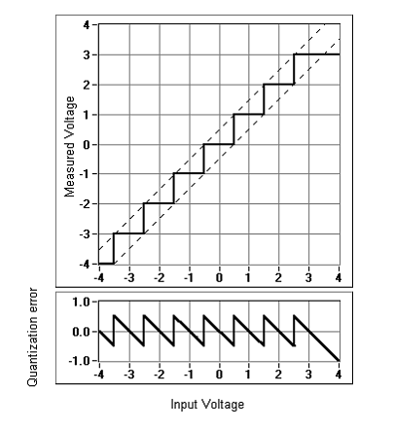
Choosing the granularity
Resolution
  Number of discrete values that represent a range of analog values
(in Bit)
  8 Bit = 2⁸ = 256 quantization level,
  10 Bit = 2¹⁰ = 1024 quantization level
  MSP430: 12-bit ADC
    4096 values
    Range / 4096 = Step
  Larger range ➔ less info / bit
Reference voltage V_{ref}: Analog input signal V_{in} is related to digital output signal D_{out} through V_{ref} with:
V_{in} = V_{ref} · (D₀2⁻¹ + D₁2⁻² + … + D_{N-1}2^{-N})
  Example: N = 3 Bit, V_{ref} = 1V, D_{out} = ‘011’
  => V_{in} = 1V · ( 2⁻² + 2⁻³) = 1V · (0.25 + 0.125) = 0.375V

Slide 13
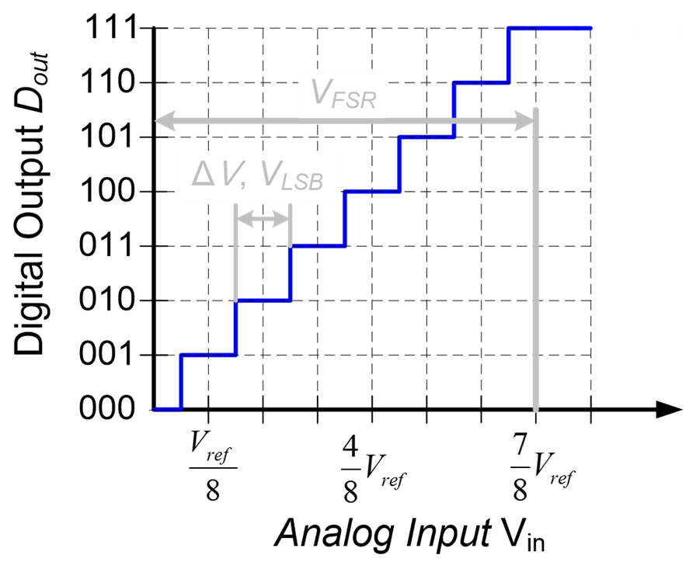
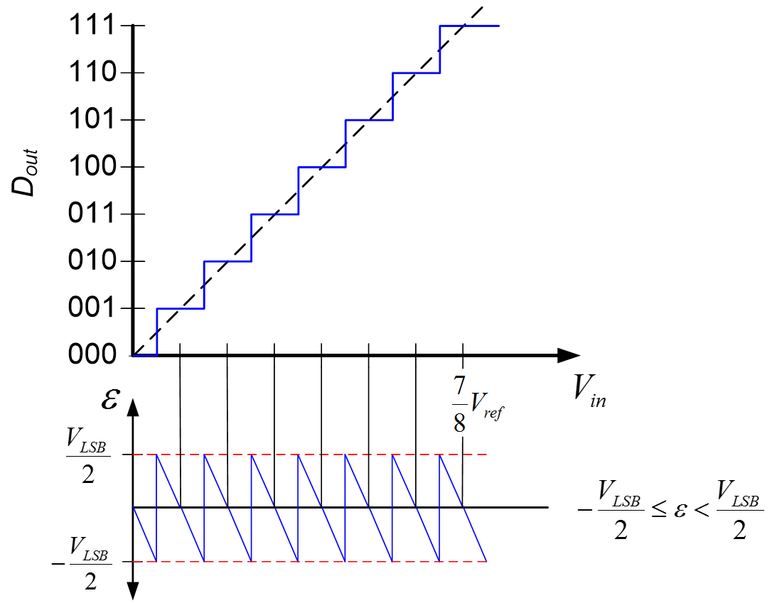
Choosing the granularity
Quantization Error
  How far off discrete value is from actual
  ½ LSB → Range / 8192
  Larger range ➔ larger error

Slide 14
Choosing the sample rate
What sample rate do we need?
  Too little: we can’t reconstruct the signal we care about
  Too much: waste computation, energy, resources

Slide 15



Shannon-Nyquist sampling theorem
If a continuous-time signal contains no frequencies higher than , it can be completely determined by discrete samples taken at a rate:
Example:
  Humans can process audio signals 20 Hz – 20 KHz
  Audio CDs: sampled at 44.1 KHz

Slide 16
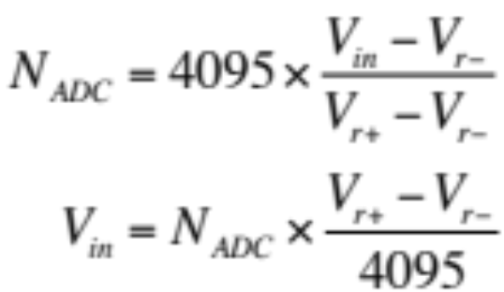


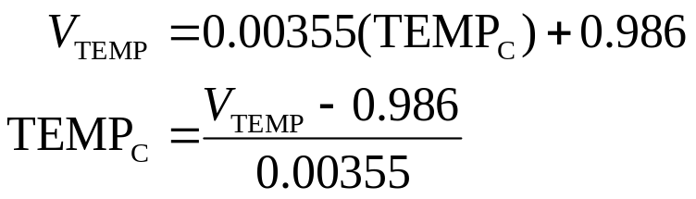
Converting between voltages,
ADC counts, and engineering units
Converting: ADC counts ⬄ Voltage
Converting: Voltage ⬄ Engineering Units

Slide 17
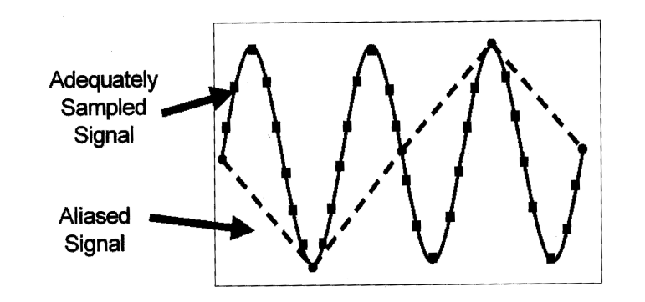
Aliased Signal
If the sampling rate is not high enough, aliased signal comes out.
To avoid aliasing, the sampling rate must be greater than twice the maximum frequency component in the signal to be acquired.

Slide 18
INTERFACING TO ADC AND SENSORS
ADCs (analog-to-digital converters) are among the most widely used devices for data acquisition
We need an analog-to-digital converter to translate the analog signals to digital numbers, so microcontroller can read them

Slide 19
INTERFACING TO ADC AND SENSORS ADC804 Chip
ADC804 IC is an analog-to-digital converter
It works with +5 volts and has a resolution of 8 bits
Conversion time is another major factor in judging an ADC
Conversion time is defined as the time it takes the ADC to convert the analog input to a digital (binary) number
In ADC804 conversion time varies depending on the clocking signals applied to CLK R and CLK IN pins, but it cannot be faster than 110 µs

Slide 20
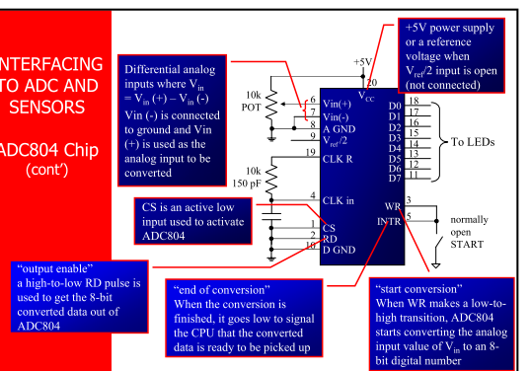

Slide 21
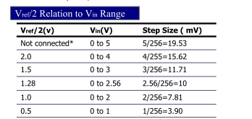
INTERFACING TO ADC AND SENSORS ADC804 Chip
V ref /2
It is used for the reference voltage
If this pin is open (not connected), the analog input voltage is in the range of 0 to 5 volts (the same as the Vcc pin)
If the analog input range needs to be 0 to 4 volts, V ref /2 is connected to 2 volts
Step size is the smallest change can be discerned by an ADC

Slide 22
INTERFACING TO ADC AND SENSORS ADC804 Chip
D0-D7
  The digital data output pins
  These are tri-state buffered
  The converted data is accessed only when CS = 0 and RD is forced low
To calculate the output voltage, use the following formula
Dout = Vin / step size
  Dout =digital data output (in decimal), ƒ
  Vin = analog voltage, and
  ƒ step size(resolution) is the smallest change

Slide 23
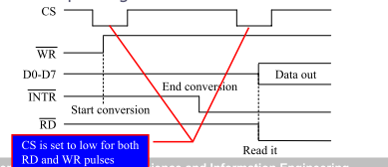
INTERFACING TO ADC AND SENSORS ADC804 Chip
The following steps must be followed for data conversion by the ADC804 chip
  Make CS = 0 and send a low-to-high pulse to pin WR to start conversion
  Keep monitoring the INTR pin
  If INTR is low, the conversion is finished
  If the INTR is high, keep polling until it goes low
  After the INTR has become low, we make CS = 0 and send a high-to-low pulse to the RD pin to get the data out of the ADC804

Slide 24
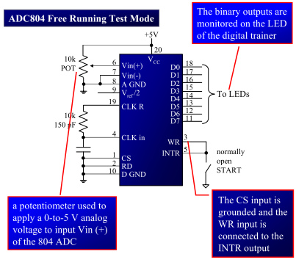

Slide 25
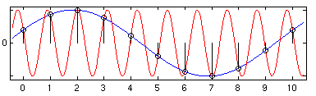
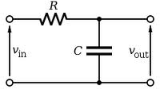
Use anti-aliasing filters on ADC inputs to ensure that Shannon-Nyquist is satisfied
Aliasing
  Different frequencies are indistinguishable when they are sampled.
Condition the input signal using a low-pass filter
  Removes high-frequency components
  (a.k.a. anti-aliasing filter)

Slide 26
Do I really need to condition my input signal?
Short answer: Yes.
Longer answer: Yes, but sometimes it’s already done for you.
  Many (most?) ADCs have a pretty good analog filter built in.
  Those filters typically have a cut-off frequency just above ½ their maximum sampling rate.
    Which is great if you are using the maximum sampling rate, less useful if you are sampling at a slower rate.

Slide 27
INTERFACINGTO ADC AND SENSORS: Interfacing Temperature Sensor
A thermistor responds to temperature change by changing resistance, but its response is not linear
The sensors of the LM34/LM35 series are precision integrated-circuit temperature sensors whose output voltage is linearly proportional to the Fahrenheit/Celsius temperature
  The LM34/LM35 requires no external calibration since it is inherently calibrated
  It outputs 10 mV for each degree of Fahrenheit/Celsius temperature

Slide 28
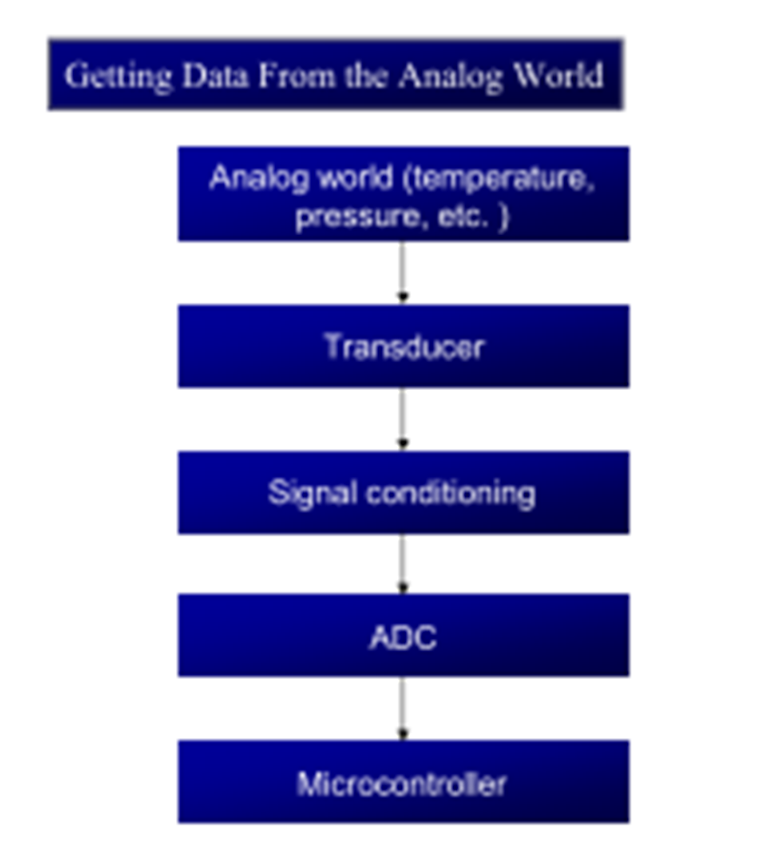
Signal Conditioning and Interfacing LM35
Signal conditioning is a widely used term in the world of data acquisition
  It is the conversion of the signals (voltage, current, charge, capacitance, and resistance) produced by transducers to voltage, which is sent to the input of an A to-D converter
Signal conditioning can be a current-to voltage conversion or a signal amplification
  The thermistor changes resistance with temperature, while the change of resistance must be translated into voltage in order to be of any use to an ADC

Slide 29
DIGITAL-TO-ANALOG (DAC) CONVERTER

Slide 30
DAC interfacing with 8051
In embedded systems, it is needed to generate analog outputs from a microcontroller.
  Examples of such include, generating audio tones, voice, music, smooth continuous waveforms, function generators, voltage reference generators, etc.,
Microcontroller are used in wide variety of applications like for measuring and control of physical quantity like temperature, pressure, speed, distance, etc.

Slide 31
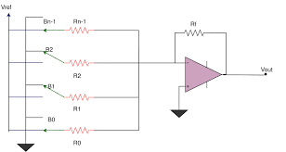
binary weighted DAC
Binary Weighted DAC contains one resistor
or current source for each bit of the DAC
connected to a summing point.
These precise voltages or currents sum
to the correct output value.
fastest conversion methods but suffers from poor accuracy because of the high precision required for each individual voltage or current.
Such high-precision resistors and current-sources are expensive, so this type of converter is usually limited to 8-bit resolution or less

Slide 32
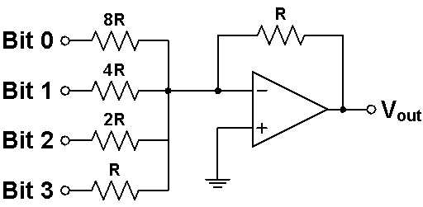
DAC R/2R ladder
A DAC can be constructed by using a Summing Amplifier and a set of resistors R, 2R, 4R and 8R as its inputs
The resistors are scaled to represent weights for the different input bits.

Slide 33
The R-2R ladder DAC, which is a binary weighted DAC that uses a repeating cascaded structure of resistor values R and 2R.
This improves the precision due to the relative ease of producing equal valued matched resistors (or current sources).
However, wide converters perform slowly due to increasingly large RC-constants for each added R-2R link
An 8-input DAC such as the DAC0808 provides 256 discrete voltage (or current) levels of output

Slide 34
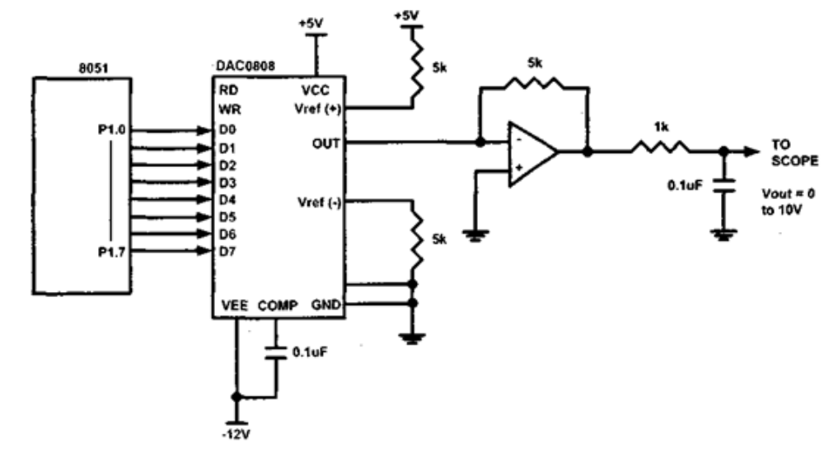
DAC0808

Slide 35
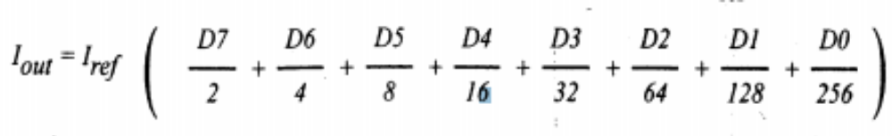
DAC0808
The digital inputs are converter to current (Iout), and by connecting a resistor to the Iout pin, we can convert the result to voltage.
The total current provided by the Iout pin is a function of the binary numbers at the D0-D7 inputs of the DAC0808 and the reference current (Iref), and is as follows
Usually reference current is 2mA.
Ideally we connect the output pin to a resistor, convert this current to voltage, and monitor the output on the scope.
But this can cause inaccuracy; hence an opamp is used to convert the output current to voltage.
The 8051 connection to DAC0808is as shown in the figure
Now assuming that Iref = 2mA, if all the inputs to the DAC are high, the maximum output current is 1.99mA.

Slide 36
DAC0808

Slide 37
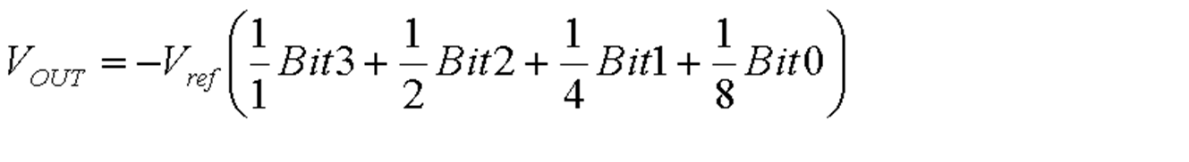
The resistor with the lowest value R corresponds to the highest weighted binary input Bit 3 (MSB) [2³ = 8], and 2R, 4R, 8R correspond to the binary weights of Bit 2 (2² = 4), Bit 1 (2¹ = 2), and Bit 0 (LSB) [2⁰ = 1] respectively.
The relationship between the digital inputs (Bit 0 to Bit 3) and the analog output V_{OUT} is as follows
where Vref is the Reference Voltage of the circuit.

Slide 38
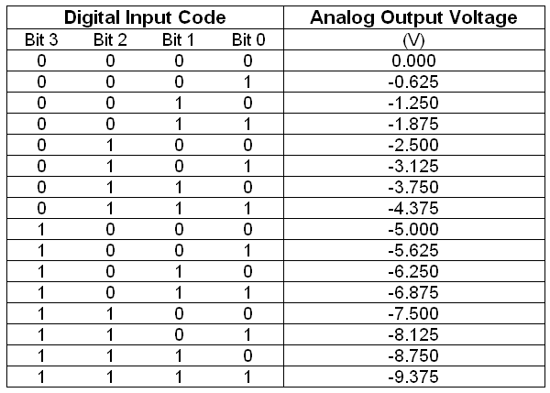
Assuming the value of V_{ref} as 5 V, the Analog Output Voltages corresponding to the Digital Input Codes is shown in Table
.

Slide 39

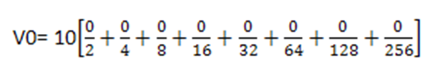
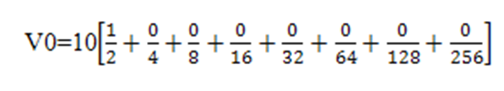
If data =00H [00000000], Vref= 10V, Therefore, V0= 0 Volts.
If data is 80H [10000000], Vref= 10V, Therefore, V0= 5 Volts.

Slide 40
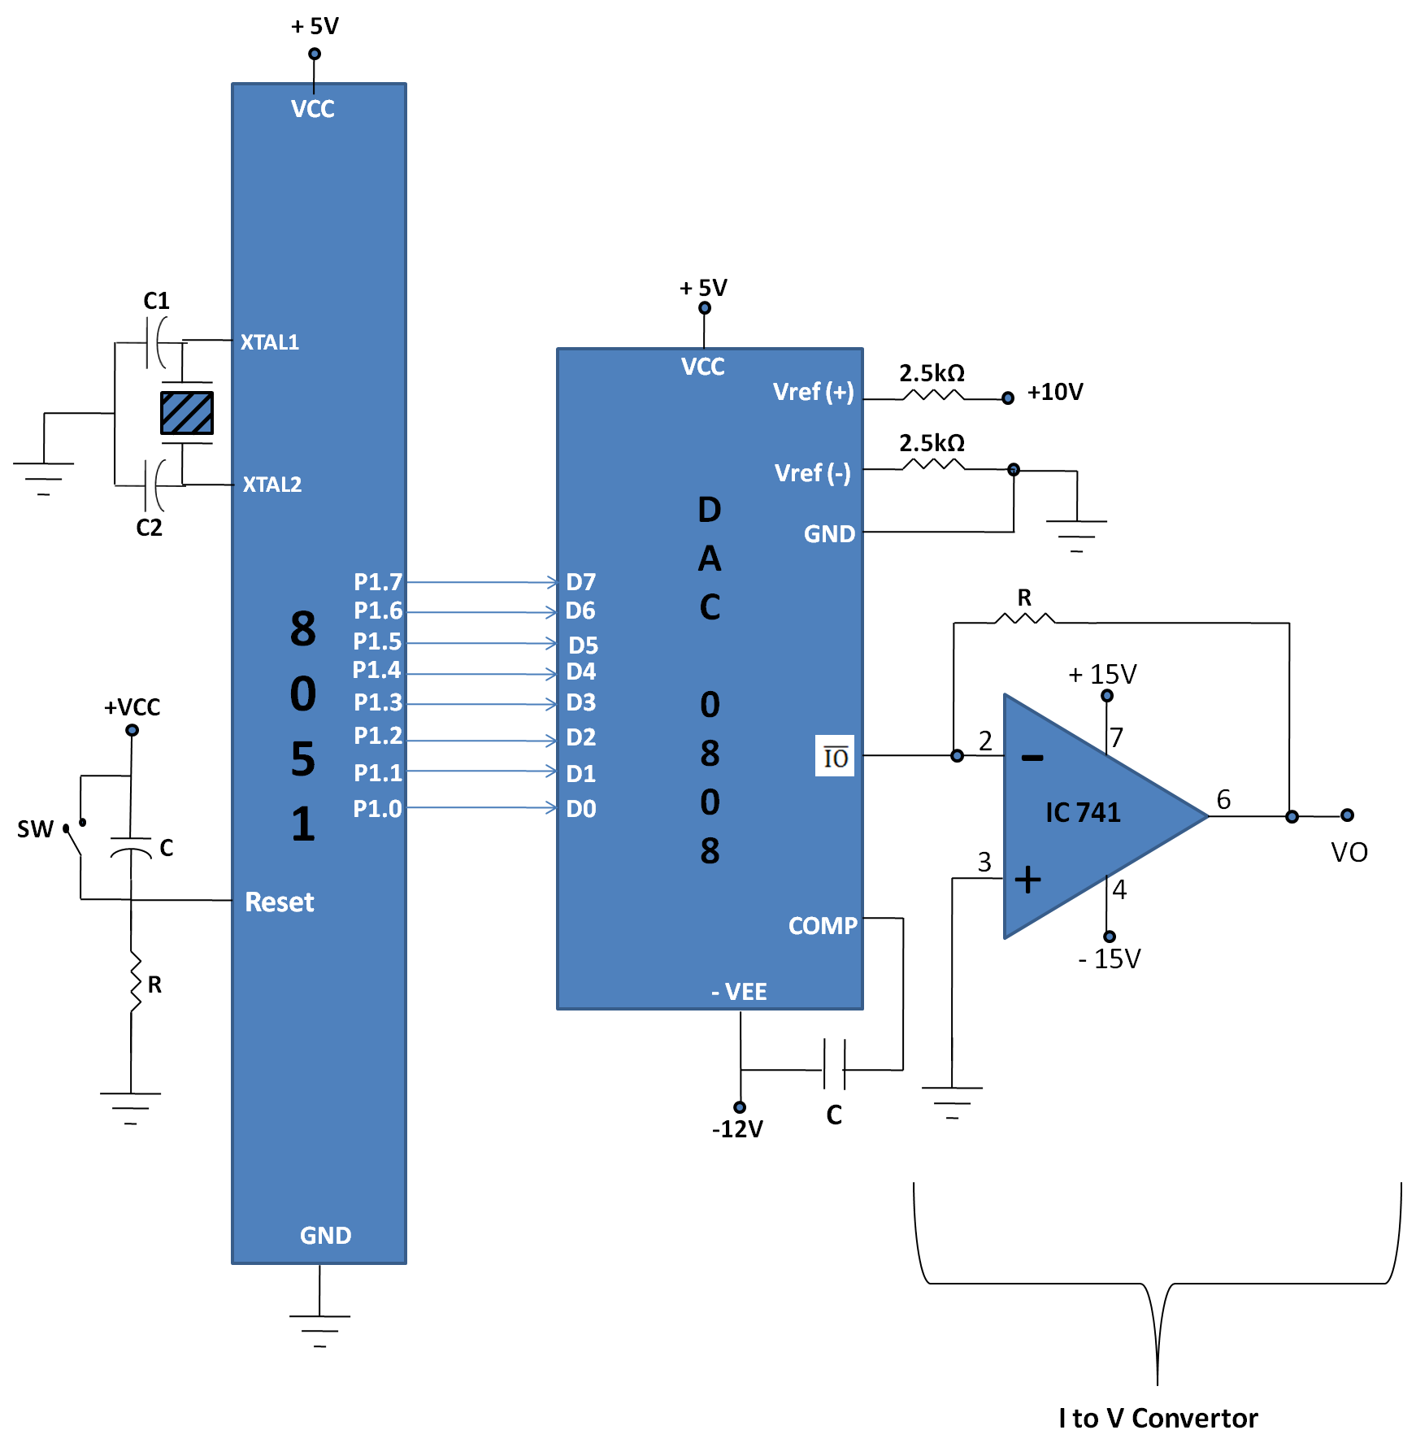
Interfacing Diagram

